Slide 1
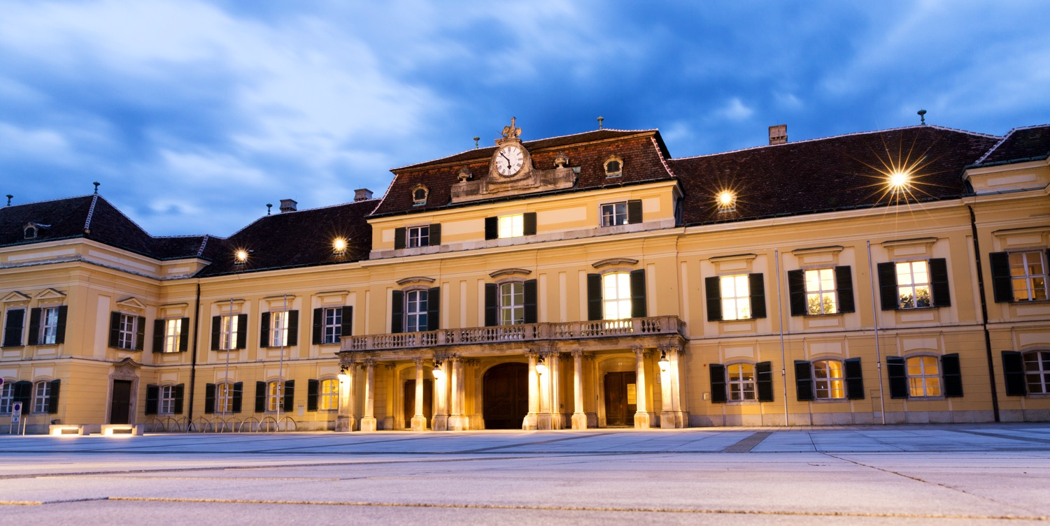
IIASA The International Institute for Applied Systems Analysis
An international research institute that conducts multidisciplinary/ transdisciplinary research to help policymakers find long-term solutions to global and universal challenges facing countries
Notes:
IIASA’s mission is well-aligned with the objectives of the Chinese government, including the Belt and Road Initiative.

Slide 2
Internationellt forsknings­institut vid slottet Laxenburg utanför Wien med cirka 350 forskare under olika anställningsformer
Forskar och utvecklar verktyg för studier av globala frågor, såsom långsiktiga förändringar av klimat, demografi och markanvändning
Ca 20 nationella medlemsorganisationer i IIASA Council
Sverige medlem sedan 1976, Formas sedan 2001
Formas driver den nationella medlemsorganisationen (NMO) och organiserar den svenska kommittén
Formas hanterar svenskt deltagande bl.a i IIASA:s Young Scientists Summer Program (YSSP)
Internationell utvärdering av IIASA 2018 -> omfattande reformarbete

Slide 3
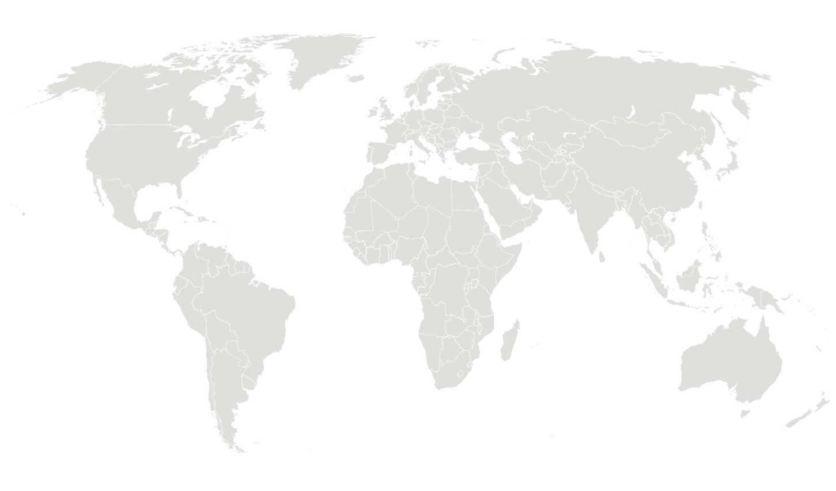
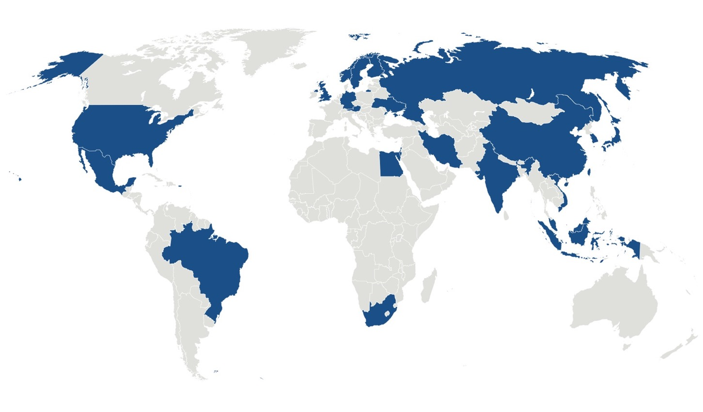
IIASA members 2019
Notes:
Annual budget in 2018 was €22.7 million, of which over 53% was from research funding agencies in member countries in Africa, the Americas, Asia, and Europe.
Competitive funding from contracts, grants, etc. between 2017 and 2018 increased by 25% from €8.4 million to €10.5 million.

Slide 4
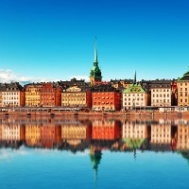
Sweden
IIASA and Swedish researchers have collaborated on a wide range of research projects focusing on reducing greenhouse gas emissions, forest management, and the transition to a sustainable energy systems in Sweden.
Other projects have explored global issues that affect Sweden such as the future of the Arctic, ecological and evolutionary dynamics, and demographic changes.
Researcher visits
34 doctoral students
Young Scientists Summer Program 2-4 per year
8 postdoctoral fellows
377 publications from IIASA-Swedish collaborations

Slide 5
Svensk kommitté
Formas har en förnyad kommitté för tillämpad systemanalys med ett bredare uppdrag att främja forskningsfältet och dess tillämpningar, med fokus på att skapa synergier och samverkan. Kommittén verkar även som nationell medlemsorganisation i IIASA (Swedish NMO).
Ordförande Göran Enander
Naturvårdsverket Hördur Haraldson
Energimyndigh. Klaus Hammes
SMHI Helén Andersson
Sida AnnaKarin Norling
HaV Mats Svensson
Formas John Tumpane
KVA Anne-Sophie Crépin
SUA Karl Wennberg
IVA Anna Nilsson Vindefjärd
Sammankallande Magnus Tannerfeldt

Slide 6
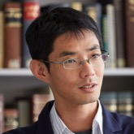
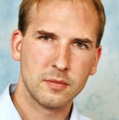
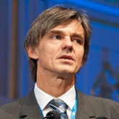
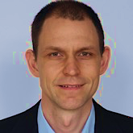
IIASA highly cited researchers Clarivate Analytics (top 1%, 2019)
Shinichiro Fujimori Energy Program
Petr Havlik Ecosystems Services and Management Program
Klaus Hubacek Water Program
Zbigniew Klimont Air Quality and Greenhouse Gases Program
Michael Obersteiner Ecosystems Services and Management Program
Volker Krey Energy Program
Keywan Riahi Energy Program
Andreas Richter Ecosystems Services and Management Program
Joeri Rogelj Energy Program
Hugo Valin Ecosystems Services and Management Program
Yoshihide Wada Water Program

Slide 7
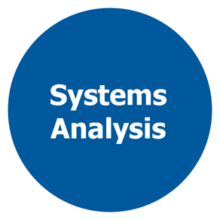
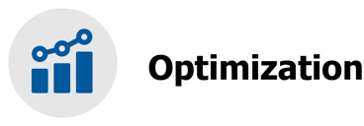
Systems Analysis: Tools of the trade

Slide 8
For further information about IIASA:
www.iiasa.ac.at
Subscribe to IIASA’s publications:
www.iiasa.ac.at/keepintouch
Monthly e-newsletter, Analyst
Twice yearly magazine, Options
Annual Report
Policy Briefs

